Slide 1
Cloud Computing – An overview

Slide 2
Agenda
Why Cloud computing ?
What is Cloud computing?
Cloud computing - Characteristics
Types of Clouds
Cloud Performance
Cloud Infrastructure
Cloud computing open issues
Cloud articles
Battle in the cloud

Slide 3
Why Cloud computing?
Data centers are notoriously underutilized, often idle 85% of the time
Over provisioning
Insufficient capacity planning and sizing
Improper understanding of scalability requirements etc
including thought leaders from Gartner, Forrester, and IDC—agree that this new model offers significant advantages for fast-paced startups, SMBs and enterprises alike.
Cost effective solutions to key business demands
Move workloads to improve efficiency

Slide 4
What is Cloud computing?
Individuals
Corporations
Non-Commercial
Cloud Middle Ware
Storage
Provisioning
OS
Provisioning
Network
Provisioning
Service(apps)
Provisioning
SLA(monitor),
Security, Billing,
Payment
Resources
Services
Storage
Network
OS

Slide 5
Cloud computing - Characteristics
Agility – On demand computing infrastructure
Linearly scalable – challenge
Reliability and fault tolerance
Self healing – Hot backups, etc
SLA driven – Policies on how quickly requests are processed
Multi-tenancy – Several customers share infrastructure, without compromising privacy and security of each of the customer’s data
Service-oriented – compose applications out of loosely coupled services. One service failure will not disrupt other services. Expose these services as API’s
Virtualized – decoupled from underlying hardware. Multiple applications can run in one computer
Data, Data, Data
Distributing, partitioning, security, and synchronization

Slide 6
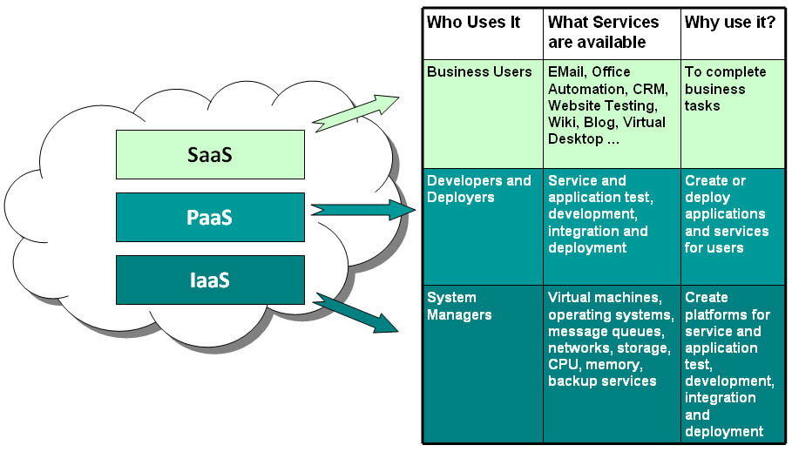
Cloud Computing - Services
Software as a Service - SaaS
Platform as a Service - PaaS
Infrastructure as a Service - IaaS
Notes:
add real examples here as needed.

Slide 7
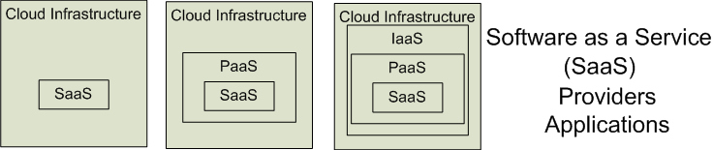

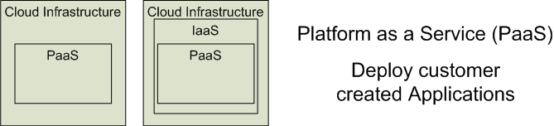

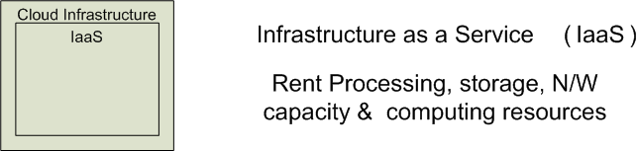


Cloud Service Providers
Software as a Service (SaaS)
Platform as a Service (PaaS)
Infrastructure as a Service (IaaS)
SalesForce CRM
LotusLive
Google App Engine
Adopted from: Effectively and Securely Using the Cloud Computing Paradigm by peter Mell, Tim Grance
Notes:
IaaSdelivers computer infrastructure, typically a platform virtualization environment, as a service. Rather than purchasing servers, software, data center space or network equipment, clients instead buy those resources as a fully outsourced service.
PaaSdeliver a computing platform where the developers can develop their own applications.
SaaSis a model of software deployment where the software applications are provided to the customers as a service.

Slide 8
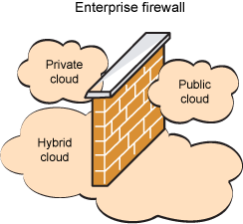
Types of Clouds
Public, Private and Hybrid clouds

Slide 9
Public clouds
Open for use by general public
Exist beyond firewall, fully hosted and managed by the vendor
Individuals, corporations and others
Amazon's Web Services and Google appEngine are examples
Offers startups and SMB’s quick setup, scalability, flexibility and automated management. Pay as you go model helps startups to start small and go big
Security and compliance?
Reliability concerns hinder the adoption of cloud
Amazon S3 services were down for 6 hours

Slide 10
Public Clouds (Now)
Large scale infrastructure available on a rental basis
Operating System virtualization (e.g. Xen, kvm) provides CPU isolation
“Roll-your-own” network provisioning provides network isolation
Locally specific storage abstractions
Fully customer self-service
Service Level Agreements (SLAs) are advertized
Requests are accepted and resources granted via web services
Customers access resources remotely via the Internet
Accountability is e-commerce based
Web-based transaction
“Pay-as-you-go” and flat-rate subscription
Customer service, refunds, etc.

Slide 11
Private Clouds
Within the boundaries(firewall) of the organization
All advantages of public cloud with one major difference
Reduce operation costs
Has to be managed by the enterprise
Fine grained control over resources
More secure as they are internal to org
Schedule and reshuffle resources based on business demands
Ideal for apps related to tight security and regulatory concerns
Development requires hardware investments and in-house expertise
Cost could be prohibitive and cost might exceed public clouds

Slide 12
Cloud Performance
Extensive performance study using HPC applications and benchmarks
Two questions:
Performance impact of virtualization
Performance impact of cloud infrastructure
Observations:
Random access disk is slower with Xen
CPU bound can be faster with Xen -> depends on configuration
Kernel version is far more important
No statistically detectable overhead
AWS small appears to throttle network bandwidth and (maybe) disk bandwidth -> $0.10 / CPU hour

Slide 13
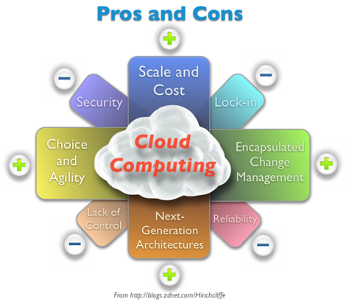
Cloud computing open issues
Governance
Security, Privacy and control
SLA guarantees
Ownership and control
Compliance and auditing
Sarbanes and Oxley Act
Reliability
Good servive provider with 99.999% availability
Cloud independence – Vendor lockin?
Cloud provider goes out of business
Data Security
Cloud lockin and Loss of control
Plan for moving data along with Cloud provider
Cost?
Simplicity?
Tools
Controls on sensitive data?
Out of business
Big and small
Scalability and cost outweigh reliability for small businesses
Big businesses may have a problem
Notes:
A service level agreement (frequently abbreviated as SLA) is a part of a service contract where the level of service is formally defined. In practice, the term SLA is sometimes used to refer to the contracted delivery time (of the service) or performance
The Sarbanes–Oxley Act of 2002 (Pub.L. 107-204, 116 Stat. 745, enacted July 30, 2002), also known as the 'Public Company Accounting Reform and Investor Protection Act' (in the Senate) and 'Corporate and Auditing Accountability and Responsibility Act' (in the House) and commonly called Sarbanes–Oxley, Sarbox or SOX

Slide 14
Battle in the cloud
Amazon Web Services
Google App Engine
Free upto 500 MB,
Free for small scale applications?
Universities?
Pay when you scale
GoGrid
.. Some more Hosting companies

Slide 15
Cloud articles
http://blogs.zdnet.com/Hinchcliffe/?p=488&tag=btxcsim
http://blogs.zdnet.com/Howlett/?p=558&tag=btxcsim
http://blogs.zdnet.com/BTL/?p=9560&tag=btxcsim
http://www.businessweek.com/technology/content/aug2008/tc2008082_445669_page_3.htm
http://www.ibm.com/developerworks/websphere/techjournal/0904_amrhein/0904_amrhein.html
http://cloudcomputing.sys-con.com/

